Slide 1
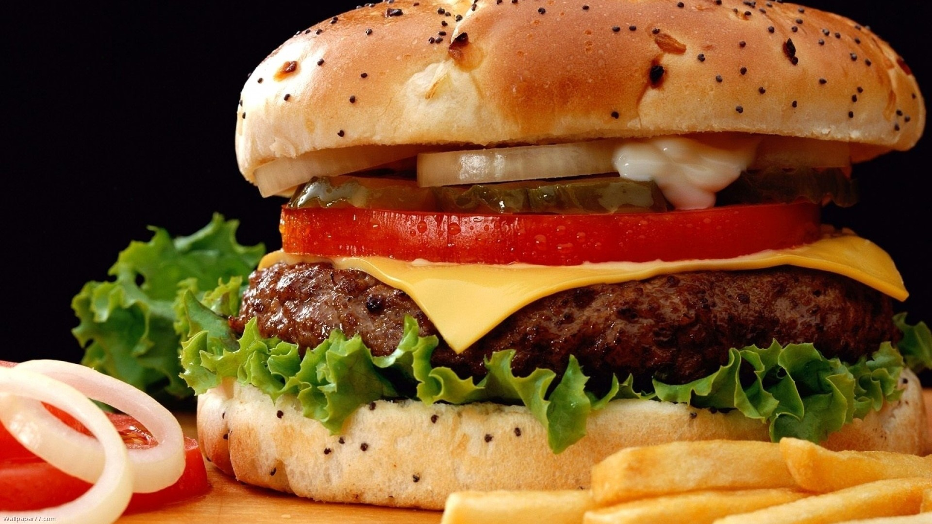
RESTAURANT MANAGEMENT SYSTEM
Project Members
Suyog Adhikari
Uttam Kharel
Arpana Guragain

Slide 2
Contents
Introduction
Objectives
System Facilities

Slide 3
Introduction
System that enables a single outlet or enterprise to better serve its customers and aid employees with food and beverage transactions and controls.
System that automates day to day financial activity of a restaurant.
System that manages customers from loyal customers to guests.

Slide 4
Objectives
to provide the restaurant owners fully efficient record storing system,
to minimize the fraud activities done by the restaurant’s employees,
to accommodate large orders, and automatically compute bills
to keep record of transactions on daily, monthly and yearly based

Slide 5
system facilities
The prime feature of the system is to track the sales and services provided by restaurant itself.
Clear billing system about the expenses done by the customer including loyalty coupon number.
Extensive discount system, if the coupon number from previous service is brought.
Special discount for those who sign up as a membership.
Prepare diagrammatic or numeric account for daily as well as monthly activity of the restaurant.

Slide 6
conclusion
All the data will be saved in the database. So the administer can view all the data on time.
System reduces manual works.
All the records of the current and ex-staffs will be stored in the database.
All the expenses per day will updated in the database daily.
All the food order details like the order types (normal, home delivery, party order etc.) are stored daily.

Slide 7
Thank you !!!

Slide 8
Any Queries Suggestions??

